Slide 1
Data Warehousing - session -4
Mr. Atul Vaze
Certified BI Specialist(OBIEE)
Certified Agile Coach (ICP-ACC)
Function Point Specialist
Six Sigma GB

Slide 2
Books
Text Books:
T1: Ponniah P, “Data Warehousing Fundamentals”, Wiley Student Edition, 2012
T2: Kimball R, “The Data Warehouse Toolkit”, 3e, John Wiley, 2013
Reference Books :
R1 : Anahory S, & Dennis M, “Data Warehousing in the Real World”, Pearson Education, 2008.
R2 : Kimball R, Reeves L, Ross M, & Thornthwaite, W, “The Data Warehouse Lifecycle Toolkit”, John Wiley, 2e, 2012.
R3: Jiawei Han, Micheline Kamber and Jian Pei, “Data Mining: Concepts and Techniques”, Morgan Kaufmann Publishers 2012
R4: Krish Krishnan, “Data Warehousing in the Age of Big Data”, Morgan Kaufmann Publishers 2013
Note: In order to broaden understanding of concepts as applied to Indian IT industry, students are advised to refer books of their choice and case-studies in their own organizations

Slide 3
TOPICS
ETL
  Process flow
  Case Study
  Function Challenges
  Pre-processing
  ETL Process steps
  General requirements
  Transformation
  ETL Tools

Slide 4
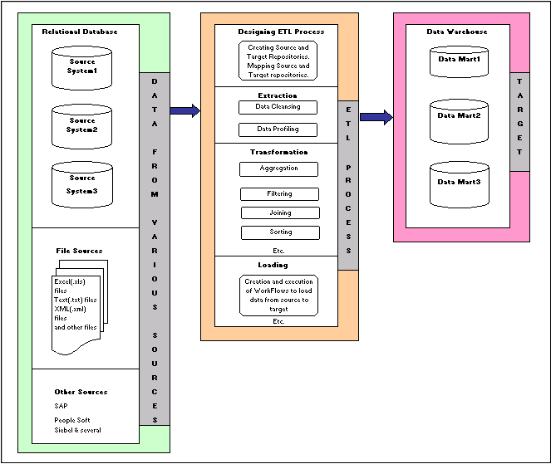
ETL Process Flow
Notes:
https://learndatamodeling.com/blog/etl-concepts/

Slide 5
ETL Process Flow
Source System:
  A database, application file, or other storage facility from which data in a data warehouse is derived
  Mapping : The definition of the relationship and data flow between source and target objects.
  Metadata :
  Data that describes data and other structures, such as objects, business rules, and processes.
    For example schema design of a data warehouse is typically stored in a repository as a metadata, which is used to generate scripts used to build and populate the data warehouse
  Staging Area: A place where data is processed before entering the warehouse
  Cleansing : The process of resolving inconsistencies and fixing anomalies in source data , typically as a part of ETL process

Slide 6
ETL Process Flow
Transformation: The process of manipulating data. Any manipulation beyond copying is transformation.
  For example cleansing , aggregating and integrating data from multiple sources.
  Transportation : The process of moving copied or transformed data from a source to a data warehouse.
  Target System: A database, application file, or other storage facility to which “transformed source data “ is loaded in a data warehouse .

Slide 7
ETL
ETL helps organizations to make meaningful, data-driven decisions by interpreting and transforming enormous amounts of structured and unstructured data. The need for ETL has increased considerably, with upsurge in data volumes. ETL functions reshape the relevant data from the source systems into useful information to be stored in the data warehouse. Without these functions, there would be no strategic information in the data warehouse.
Extracts data from homogeneous or heterogeneous data sources
Transforms the data for storing it in proper format or structure for querying and analysis purpose
Loads it into the final target (database, more specifically, operational data store, data mart, or data warehouse)

Slide 8
ETL Process:
Extracting the data from different sources – the data sources can be files (like CSV, JSON, XML) or RDBMS etc.
  This is the first step in ETL process. It covers data extraction from the source system and makes it accessible for further processing.
  The main objective of the extraction step is to retrieve all required data from source system with as little resources as possible.
  The extraction step should be designed in a way that it does not negatively affect the source system. Most data projects consolidate data from different source systems.
  Each separate source uses a different format. Common data-source formats include RDBMS, XML (like CSV, JSON). Thus the extraction process must convert the data into a format suitable for further transformation.
Notes:
Note : ETT(Extract , Transformation , Transportation) and ETM(Extraction Transformation , Move) are sometimes used instead of ETL

Slide 9
ETL Process:
2. Transforming the data – this may involve cleaning, filtering, validating and applying business rules.
In this step, certain rules are applied on the extracted data. The main aim of this step is to load the data to the target database in a cleaned and general format (depending on the organization’s requirement). This is because when the data is collected from different sources each source will have their own standards like –
For example if we have two different data sources A and B. In source A, date format is like dd/mm/yyyy, and in source B, it is yyyy-mm-dd. In the transforming step we convert these dates to a general format. The other things that are carried out in this step are:
  Cleaning (e.g. “Male” to “M” and “Female” to “F” etc.)
  Filtering (e.g. selecting only certain columns to load)
  Enriching (e.g. Full name to First Name , Middle Name , Last Name)
  Splitting a column into multiple columns and vice versa
  Joining together data from multiple sources
In some cases data does not need any transformations and here the data is said to be “rich data” or “direct move” or “pass through” data.
Notes:
Note : ETT(Extract , Transformation , Transportation) and ETM(Extraction Transformation , Move) are sometimes used instead of ETL

Slide 10
ETL Process:
3. Loading – data is loaded into a data warehouse or any other database or application that houses data.
This is the final step in the ETL process. In this step, the extracted data and transformed data is loaded to the target database. In order to make data load efficient, it is necessary to index the database and disable constraints before loading the data.
All the three steps in the ETL process can be run parallel. Data extraction takes time and so the second step of transformation process is executed simultaneously. This prepares data for the third step of loading. As soon as some data is ready it is loaded without waiting for completion of the previous steps.

Slide 11
ETL Case Study
The user wants to compare and analyze sales by store, by product, and by month. The sale figures are available in the several sales applications in your company. Also, you have a product master file. Further, each sales transaction refers to a specific store. All these are pieces of data in the source operational systems. For doing the analysis, you have to provide information about the sales in the data warehouse database. You have to provide the sales units and dollars in a fact table, the products in a product dimension table, the stores in a store dimension table, and months in a time dimension table. How do you do this? Extract the data from each of the operational systems, reconcile the variations in data representations among the source systems, and transform all the sales of all the products. Then load the sales into the fact and dimension tables. Now, after completion of these three functions, the extracted data is sitting in the data warehouse, transformed into information, ready for analysis.
Notice that it is important for each function to be performed, and performed in sequence.

Slide 12
ETL Function Challenges
ETL functions are challenging primarily because of the nature of the source systems.
Source systems are very diverse and disparate.
There is usually a need to deal with source systems on multiple platforms and different operating systems.
Many source systems are older legacy applications running on obsolete database technologies.
Generally, historical data on changes in values are not preserved in source operational systems. Historical information is critical in a data warehouse.
Quality of data is dubious in many old source systems that have evolved over time.
Source system structures keep changing over time because of new business conditions. ETL functions must also be modified accordingly.

Slide 13
ETL Function Challenges
Gross lack of consistency among source systems is commonly prevalent. Same data
is likely to be represented differently in the various source systems.
- For example, data on salary may be represented as monthly salary, weekly salary,
and bimonthly salary in different source payroll systems.
Even when inconsistent data is detected among disparate source systems, lack of a
means for resolving mismatches escalates the problem of inconsistency.
Most source systems do not represent data in types or formats that are meaningful
to the users. Many representations are cryptic and ambiguous.

Slide 14
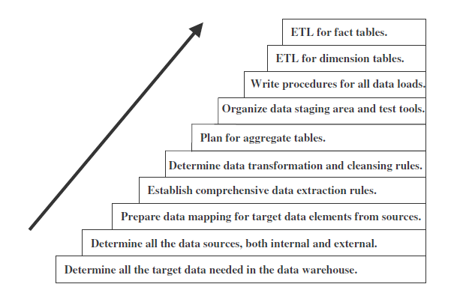
Steps in ETL Process
What are the major steps in the ETL process?

Slide 15
Why Data Requires Pre-processing?
Data preprocessing is a data mining technique that involves transforming raw data into an understandable format. Real-world data is often incomplete, inconsistent, and/or lacking in certain behaviors or trends, and is likely to contain many errors. Data preprocessing is a proven method of resolving such issues. Data preprocessing prepares raw data for further processing.
Data preprocessing is used database-driven applications such as customer relationship management and rule-based applications
Data goes through a series of steps during preprocessing:
Data Cleaning: Data is cleansed through processes such as filling in missing values,
smoothing the noisy data, or resolving the inconsistencies in the data.
Data Integration: Data with different representations are put together and conflicts within
the data are resolved.
Data Transformation: Data is normalized, aggregated and generalized.
Data Reduction: This step aims to present a reduced representation of the data in a data
warehouse.

Slide 16
Major types of transformations
ETL Transform
Transformation refers to the cleansing and aggregation that may need to happen to data to prepare it for analysis. Architecturally speaking, there are two ways to approach ETL transformation:
  Multistage data transformation – This is the classic extract, transform, load process. Extracted data is moved to a staging area where transformations occur prior to loading the data into the warehouse.
  In-warehouse data transformation – In this approach, the process flow changes to something more like ELT. Data is extracted and loaded into the analytics warehouse, and transformations are done there.
In recent years, there has been a shift toward transforming data within the warehouse rather than transforming it beforehand, primarily driven by two factors:
The increased performance and scalability of the modern analytics database
The ability for in-database transformations to be written in SQL, the data manipulation language of choice for most analysts

Slide 17
ETL Transformation Types
Basic transformations:
  Cleaning: Mapping NULL to 0 or "Male" to "M" and "Female" to "F," date format consistency, etc.
  Deduplication: Identifying and removing duplicate records
  Format revision: Character set conversion, unit of measurement conversion, date/time conversion, etc.
  Key restructuring: Establishing key relationships across tables

Slide 18
ETL Transformation Types
Advanced transformations:
  Derivation: Applying business rules to your data that derive new calculated values from existing data – for example, creating a revenue metric that subtracts taxes
  Filtering: Selecting only certain rows and/or columns
  Joining: Linking data from multiple sources – for example, adding ad spend data across multiple platforms, such as Google Adwords and Facebook Ads
  Splitting: Splitting a single column into multiple columns
  Data validation: Simple or complex data validation – for example, if the first three columns in a row are empty then reject the row from processing
  Summarization: Values are summarized to obtain total figures which are calculated and stored at multiple levels as business metrics – for example, adding up all purchases a customer has made to build a customer lifetime value (CLV) metric
  Aggregation: Data elements are aggregated from multiple data sources and databases
  Integration: Give each unique data element one standard name with one standard definition. Data integration reconciles different data names and values for the same data element.

Slide 19
General ETL Requirements
Productivity support
  Basic development environment capabilities like code library management, check in/check out, version control etc.
Usability
  Must be as usable as possible
  GUI based
  System documentation: developers should easily capture information about processes they are creating
  This metadata should be available to all
  Data compliance
Metadata Driven
  Services that support ETL process must be metadata driven

Slide 20
General ETL Requirements
Business needs – Users’ information requirement
Compliance – must provide proof that the data reported is not manipulated in any way
Data Quality – garbage in garbage out!!
Security – do not publish data widely to all decision makers
Data Integration – Master Data Management System (MDM). Conforming dimensions and facts
Data Latency – huge effect on ETL architecture
  Use efficient data processing algorithms, parallelization, and powerful hardware to speed up batch-oriented data flows
  If the requirement is for Real-time, then architecture must make a switch from batch to microbatch or stream-oriented
Archiving & Lineage – must for compliance & security reasons
  After ever major activity of the ETL pipeline, writing the data to disk (staging) is recommended
  All staged data should be archived

Slide 21
Choice of Architecture →
Tool Based ETL
Simpler, Cheaper & Faster development
People with business skills & not much technical skills can use it.
Automatically generate Metadata
Automatically generates data Lineage & data dependency analysis
Offers in-line encryption & compression capabilities
Manage complex load balancing across servers

Slide 22
Choice of Architecture →
Hand-Coded ETL
Quality of tool by exhaustive unit testing
Better metadata
Requirement may be just file based processes not database-stored procedures
Use of existing legacy routines
Use of in-house programmers
Unlimited flexibility
Cheaper

Slide 23
Middleware & Connectivity Tools
Provide transparent access to source systems in heterogeneous computing environments
Expensive but often prove invaluable because they provide transparent access to DBs of different types, residing on different platforms
Examples:
  IBM: Data Joiner
  Oracle: Transparent Gateway
  SAS: SAS/Connect
  Sybase: Enterprise Connect

Slide 24
Extract
Extract
  What data you want in the DW?
Remember that not all data generated by operational systems is required in the DW
  For example: credit card no. is mandatory in operational systems but is not required in a DW
Typically implemented as a GUI
Table names and their schema is displayed for extraction
Tables are selected and then their attributes are selected

Slide 25
Extraction Tools
Lot of tools available in the market
Tool selection tedious
Choice of tool depends on following factors:
  Source system platform and DB
  Built-in extraction or duplication functionality
  Batch windows of the operational systems

Slide 26
Extraction Methods
Bulk Extractions
  Entire DW is refreshed periodically
  Heavily taxes the network connections between the source & target DBs
  Easier to set up & maintain
Change-based Extractions
  Only data that have been newly inserted or updated in the source systems are extracted & loaded into the DW
  Places less stress on the network but requires more complex programming to determine when a new DW record must be inserted or when an existing DW record must be updated

Slide 27
Transformation Tools
Transform extracted data into the appropriate format, data structure, and values that are required by the DW
Features provided:
  Field splitting & consolidation
  Standardization
    Abbreviations, date formats, data types, character formats, time zones, currencies, metric systems, product keys, coding, etc.
  Deduplication
    A major non trivial task

Slide 28
Source System | Type of transformation | DW
Address Field: #123 ABC Street XYZ City 1000 Republic of MN | Field Splitting | No: 123 Street: ABC City: XYZ Country: Republic of MN Postal Code: 1000
System A Customer title: President System B Customer title: CEO | Field Consolidation | Customer title: President & CEO
Order Date:05 August 1998 Order Date: 08/08/98 | Standardization | Order Date: 05 August 1998 Order Date: 08 August 1998
System A Customer Name: John W. Smith System B Customer Name: John William Smith | Deduplication | Customer Name: John William Smith

Slide 29
Mission of ETL team
To build the back room of the DW
  Deliver data most effectively to end user tools
  Add value to the data in the cleaning & conforming steps
  Protect & document the lineage of data (data provenance)

Slide 30
Mission of ETL team
The back room must support 4 key steps
  Extracting data from original sources
  Quality assuring & cleaning data
  Conforming the labels & measures in the data to achieve consistency across the original sources
  Delivering the data in a physical format that can be used by query tools and report writers

Slide 31
ETL Data Structures
Data Flow
Extract ➔ Clean ➔ Conform ➔ Deliver
Back room of a DW is often called the data staging area
Staging means ‘writing to disk’
ETL team needs a number of different data structures for all kinds of staging needs

Slide 32
To stage or not to stage
Decision to store data in physical staging area versus processing it in memory is ultimately the choice of the ETL architect

Slide 33
To stage or not to stage
A conflict between
  getting the data from the operational systems as fast as possible
  having the ability to restart without repeating the process from the beginning
Reasons for staging
  Recoverability: stage the data as soon as it has been extracted from the source systems and immediately after major processing (cleaning, transformation, etc).
  Backup: can reload the data warehouse from the staging tables without going to the sources
  Auditing: lineage between the source data and the underlying transformations before the load to the data warehouse

Slide 34
Designing the Back Room
The back room is owned by the ETL team
  no indexes, no aggregations, no presentation access, no querying, no service level agreements
Users are not allowed in the back room for any reason
  Back room is a “construction” site
Reports cannot access data in the back room
  tables can be added, or dropped without notifying the user community
  Controlled environment

Slide 35
Designing the Back Room (contd…)
Only ETL processes can read/write in the back room (ETL developers must capture table names, update strategies, load frequency, ETL jobs, expected growth and other details about the staging area)
The back room consists of both RDBMS tables and data files

Slide 36
Data Structures in the ETL System
Flat files
  fast to write, append to, sort and filter (grep) but slow to update, access or join
XML Data Sets
  Used as a medium of data transfer between incompatible data sources
Relational Tables

Slide 37
Some of the ETL Tools
PowerCenter Informatica
SAP Data Services
Oracle Warehouse Builder (OWB)
SQL Server Integration Services (SSIS)
Talend Studio for Data Integration
Oracle Data Integrator (ODI)
Cognos Data Manager
Pentaho Data Integration
QlikView Expressor

Slide 38
ETL Tool Selection
Which ETL tool, one is going to use depends on certain factors. Below is the list of factors those play very important role in choosing the particular ETL tool for the organization.
Infrastructure
Functionality
Usability
Platforms supported
Debugging facilities
Data Quality / profiling
Performance
Future prospects
Reusability
ScalabilityBatch vs Real-time√Native connectivity

Slide 39
34 Subsystems of ETL
Extracting (1-3)
Cleaning & Conforming Data (4-8)
Prepare for Presentation (9-21)
Managing the ETL Environment (22-34)

Slide 40
Managing the ETL Environment (22-34)
A DW system can have great dimensional model & well deployed applications
Will not be successful until it is relied upon as a dependable source for decision making
DW must build a reputation for providing timely, consistent and reliable data to empower the business
To achieve this goal, ETL system must fulfill three criteria:
  Reliability
  Availability
  Manageability

Slide 41
Managing the ETL Environment (22-34)
For a first course on Data Warehousing, managing the ETL environment is not required
Will discuss the subsystems 22-34 as and when need arises as we move forward
Subsystems are being enumerated for the sake of completeness

Slide 42
Managing the ETL Environment (22-34)
Job Scheduler
Backup Systems
Recovery & Restart System
Version Control System
Version Migration System
Workflow Monitor
Sorting System
Lineage & Dependency Analyzer
Problem Escalating System
Parallelizing/Pipelining System
Security System
Compliance Manage
Metadata Repository Manager

Slide 43
Conclusion
Key building blocks of ETL system introduced
Next is to use these building blocks to assemble the ETL system
Building an ETL system is unusually challenging
34 subsystems working in tandem

Slide 44
Thank You
Any Questions?

